Slide 1
Warehouse Data Capture
HHT App
Version 1.0

Slide 2
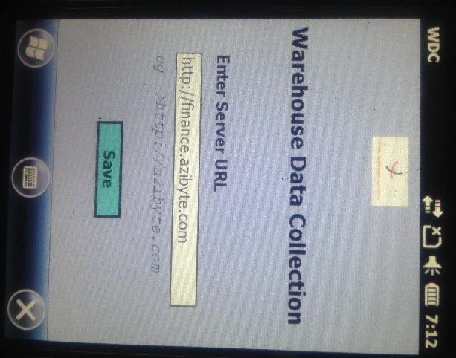
After the App is launched on HHT,
It prompts the user to enter the
server url. It is the URL where the WDC Bakend is hosted and accessed from.
This is only asked once on the first
launch.

Slide 3
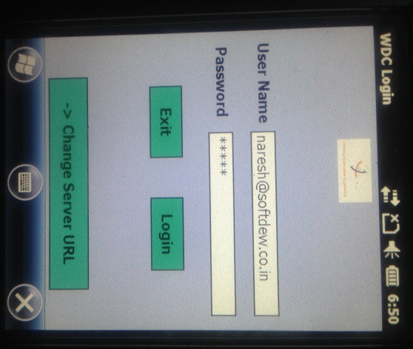
User can login using the
given username and password
created from the WDC backend

Slide 4
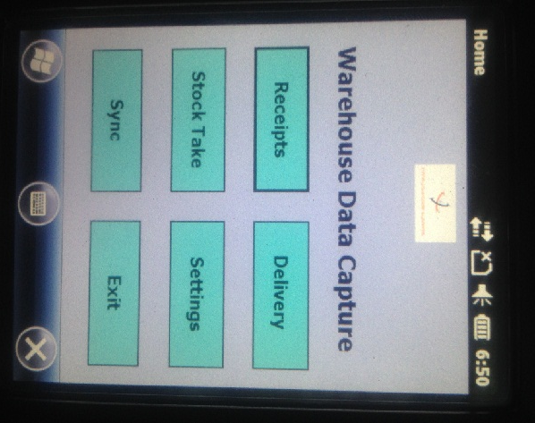
This is the WDC Home page. It provides
Reciepts against PO
Delivery against SO
Stock Take as per count sheets
Settings
Sync with WDC backend

Slide 5
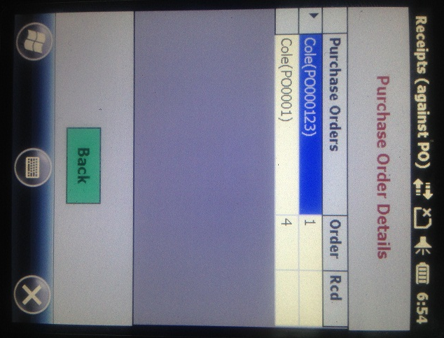
It shows all the PO assigned to
this user.
Each PO’s vendor name(PO number),
Order Items and rcvd status is shown.
Double tapping on the
grey column ( where arrow is shown)
Takes the user to the PO detail page.

Slide 6
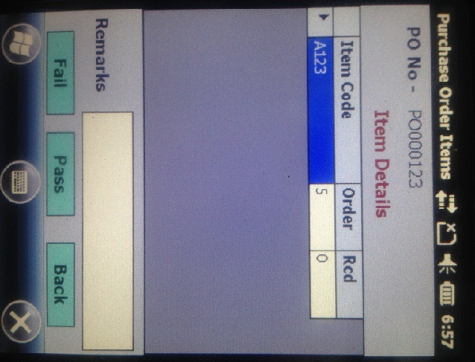
The PO Item details are shown in this
Page.
Double tapping on the
grey column ( where arrow is shown)
Shows the Item detail page.
Each PO’s status can be marked as ‘Pass’ or ‘Fail’ by the user. By default PO’s status is ‘Open’. All the Pass/Fail marked PO’s are sent to server on ‘Sync’ and deleted from HHT database locally.

Slide 7
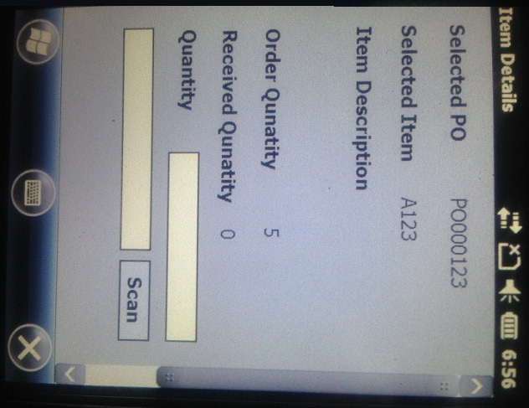
In this item detail page, user can
Enter following item information
Quantity
Scan the bar code
Batch number
Serial number
After the user enters the Quantity and saves it then next time it shows the last saved quantity against Received Quantity label

Slide 8
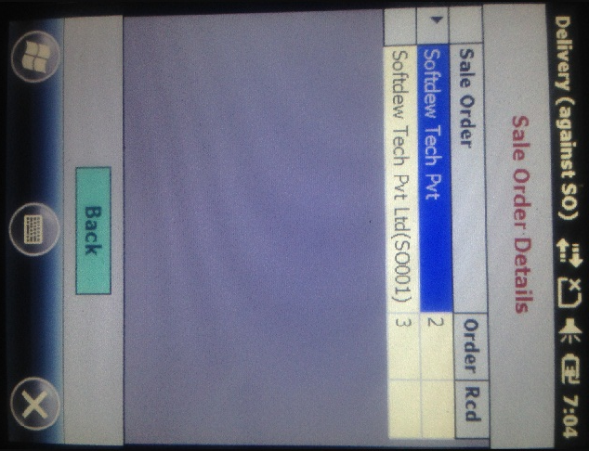
It shows all the SO assigned to
this user.
Each SO’s customer name(SO number),
Order Items and rcvd status is shown.
Double tapping on the
grey column ( where arrow is shown)
Takes the user to the SO detail page.

Slide 9
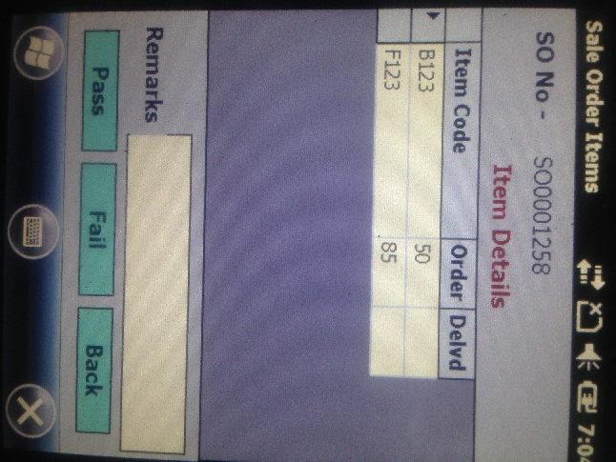
The SO Item details are shown in this
Page.
Double tapping on the
grey column ( where arrow is shown)
Shows the Item detail page
Each SO’s status can be marked as ‘Pass’ or ‘Fail’ by the user. By default SO’s status is ‘Open’. All the Pass/Fail marked SO’s are sent to server on ‘Sync’ and deleted from HHT database locally.

Slide 10
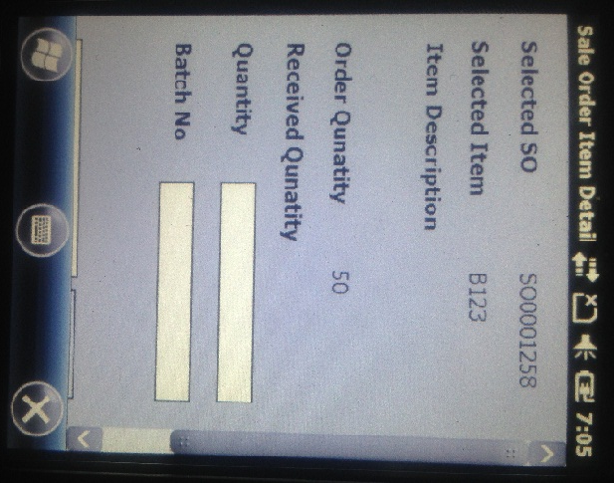
In this item detail page, user can
Enter following item information
Quantity
Scan the bar code
Batch number
Serial number
After the user enters the Quantity/Batch/Serial number/barcode and saves it then next time it shows the last saved values in the provided text boxes which user can change again if so.

Slide 11
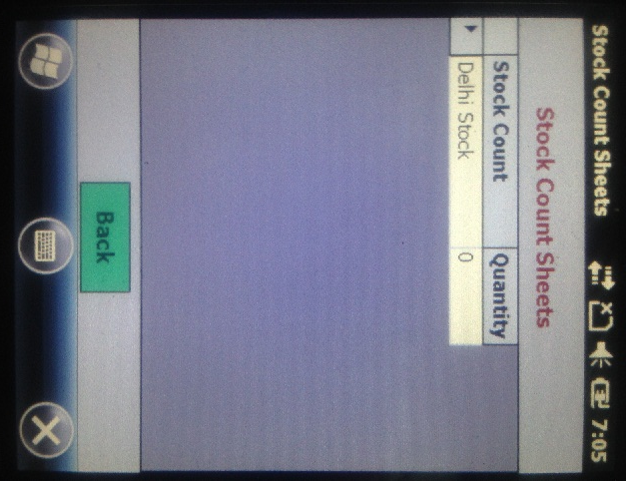
It shows all the Stock count sheets
assigned to this user.
Each SC sheet shows name,
And number of Items.
Double tapping on the
grey column ( where arrow is shown)
Takes the user to the SC detail page.

Slide 12
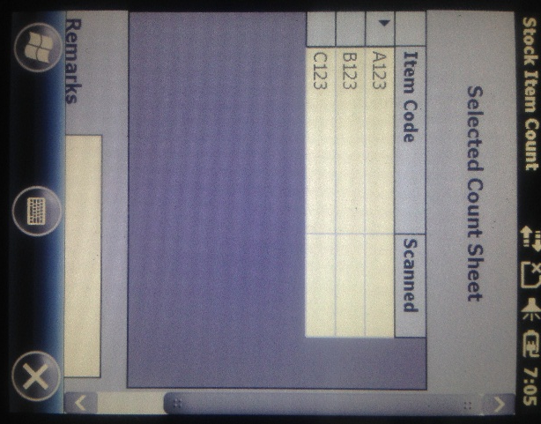
The SC Item details are shown in this
Page.
Double tapping on the
grey column ( where arrow is shown)
Shows the Item detail page
Each SC’s status can be marked as ‘Done’ by the user. By default SC’s status is ‘Open’. All the SC’s marked Done are sent to server on ‘Sync’ and deleted from HHT database locally.

Slide 13
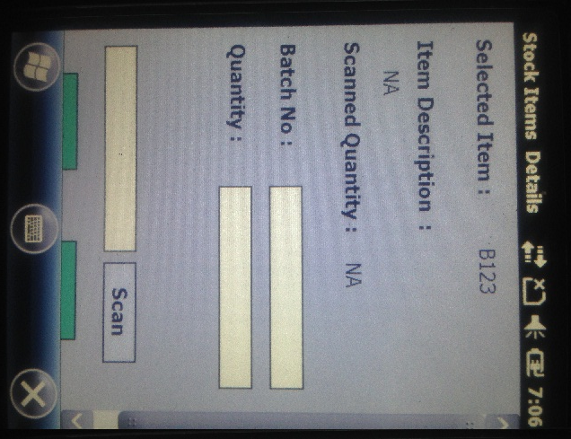
In this item detail page, user can
Enter following item information
Quantity
Scan the bar code
Batch number
Serial number
After the user enters the Quantity/Batch/Serial number/barcode and saves it then next time it shows the last saved values in the provided text boxes which user can change again if so.

Slide 14
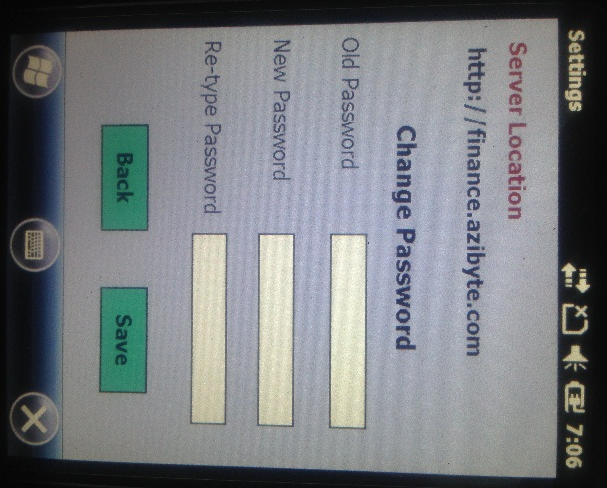
WDC Settings
- User can change his password.

Slide 15
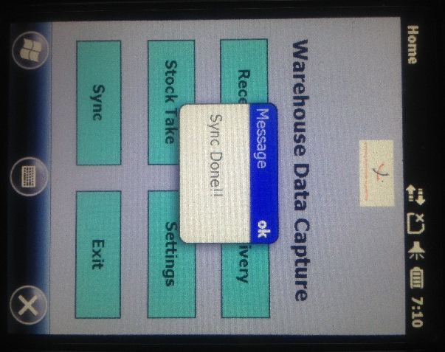
‘Sync’ button does following
Sends all the PO/SO/SC to server whose status is changed by user to Pass/Fail/Done.
Retrieves any new PO/SO/SC assigned to user

